Slide 1

Marketing Campaign Performance Analysis Data-driven insights to optimize ROAS & ad spend
Notes:
Line spacing + Page numbers

Slide 2
Objective
-Evaluate campaign performance across platforms, countries, industries ,and campaign types .
-Identify drivers of ROAS .
-Support data-driven budget decisions.

Slide 3
Methodology
T-test: ROAS by platform
ANOVA: conversions by campaign type
ANOVA: conversions by country

Slide 4
Regression Analysis
Two regression models were applied to identify the key drivers of performance.
The results show a statistically significant model (p-value < 0.001) with moderate explanatory power (R² ≈ 0.32 and 0.52).
Key findings:
CTR has a positive effect on both ROAS and conversions, indicating that higher engagement improves performance
CPC has a strong negative impact, meaning higher cost per click reduces efficiency
CPA also shows a negative relationship with performance, confirming that cost efficiency is critical
Ad spend has a positive effect on conversions, but its impact on efficiency is limited compared to cost metrics
💡 Business Insight
Performance is mainly driven by cost efficiency (CPC & CPA) rather than just increasing ad spend.
This confirms that optimizing costs is more impactful than scaling budget alone

Slide 5
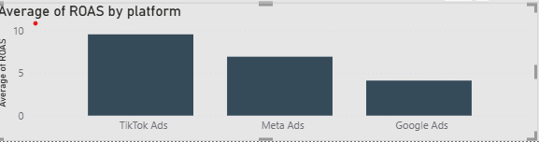
Key Result (Platforms)
Platform affects ROAS significantly → Different platforms = different ROAS

Slide 6
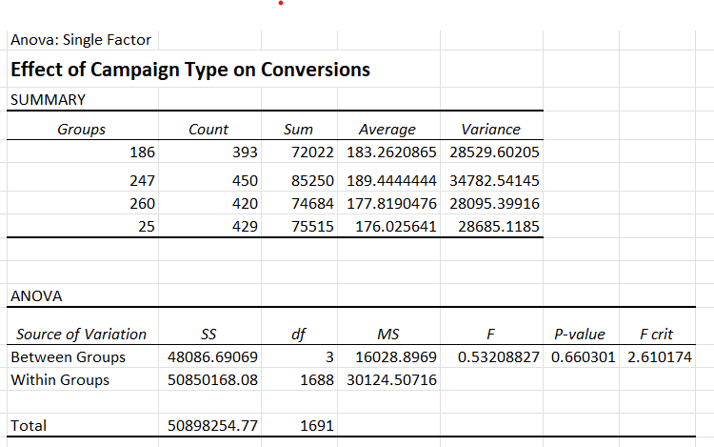
Key Result (Campaign Types)
No significant difference in conversions → Campaign type alone is not a strong drive

Slide 7
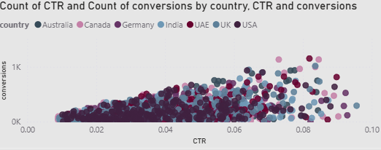
Key Result (Countries)
No significant difference in conversions → Volume is stable across markets

Slide 8
Conversion ≠ Profit ROAS varies despite similar conversions
Business Insight

Slide 9
Spend vs ROAS
Shift budget to high ROAS markets (UAE, India) .
Optimize low-efficiency markets (USA, Australia) .
Focus on cost efficiency (CPA, CPC) .

Slide 10
Final Conclusion
-Cost efficiency is the real driver of performance -Smarter budget allocation = higher ROI

